Slide 1
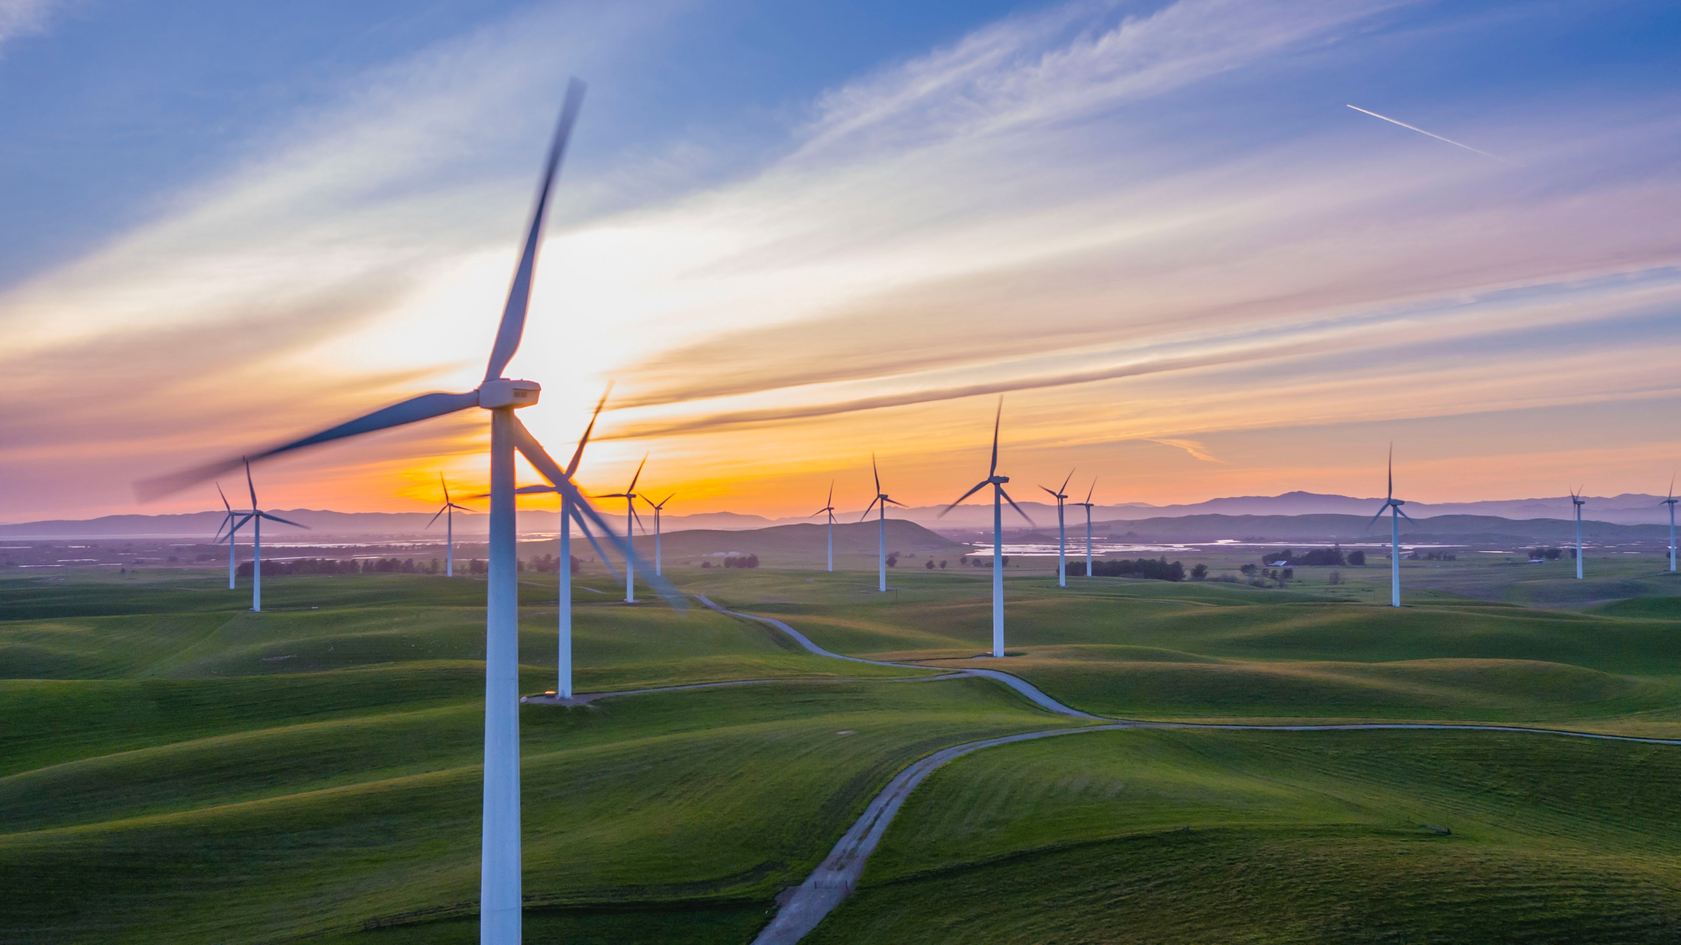
Natural resources

Slide 2
Renewables

Slide 3
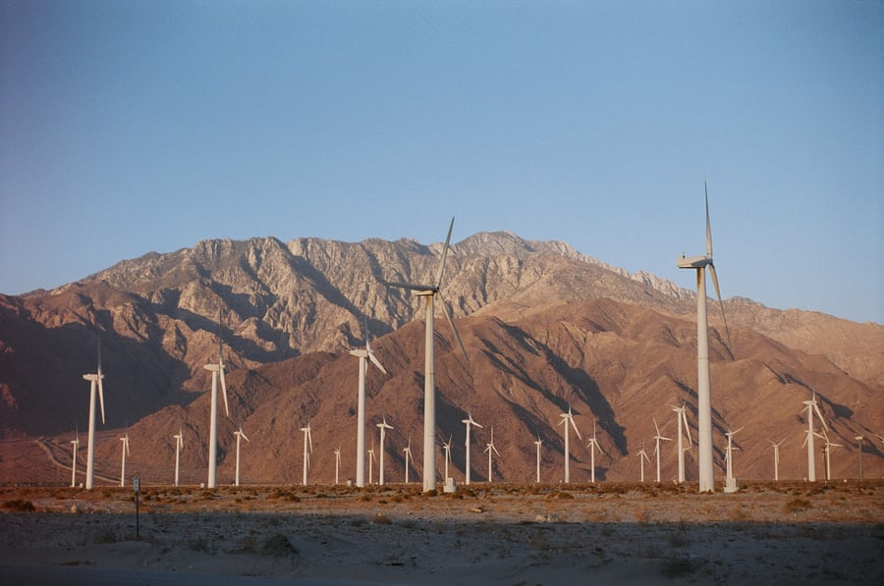
Wind turbines

Slide 4
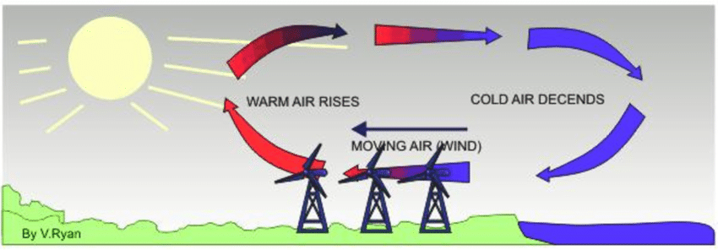
- uneven heating of atmosphere by sun
- air is heated up by sun —> rises
- produces area of low pressure
- cooler air moves in under hot air
- this patters on air movement causes wind
What causes wind?

Slide 5
- wind moves blades (kinetic NRG doing work)
- blades attached to large gear (work is done to move gear)
- Gear spins turbine —> generates electricity (converts kinetic energy into stored energy)
- energy neither created nor destroyed so energy is converted from one form to another
- main idea behind all energy sources
Wind generating electricity

Slide 6
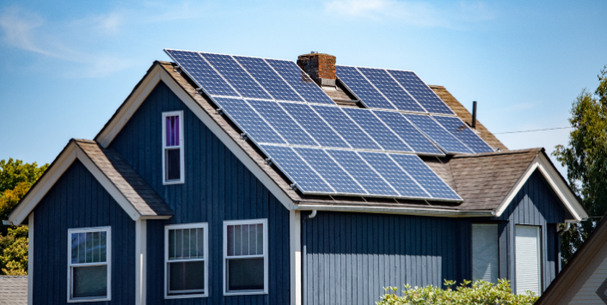
Solar power with sunlight

Slide 7
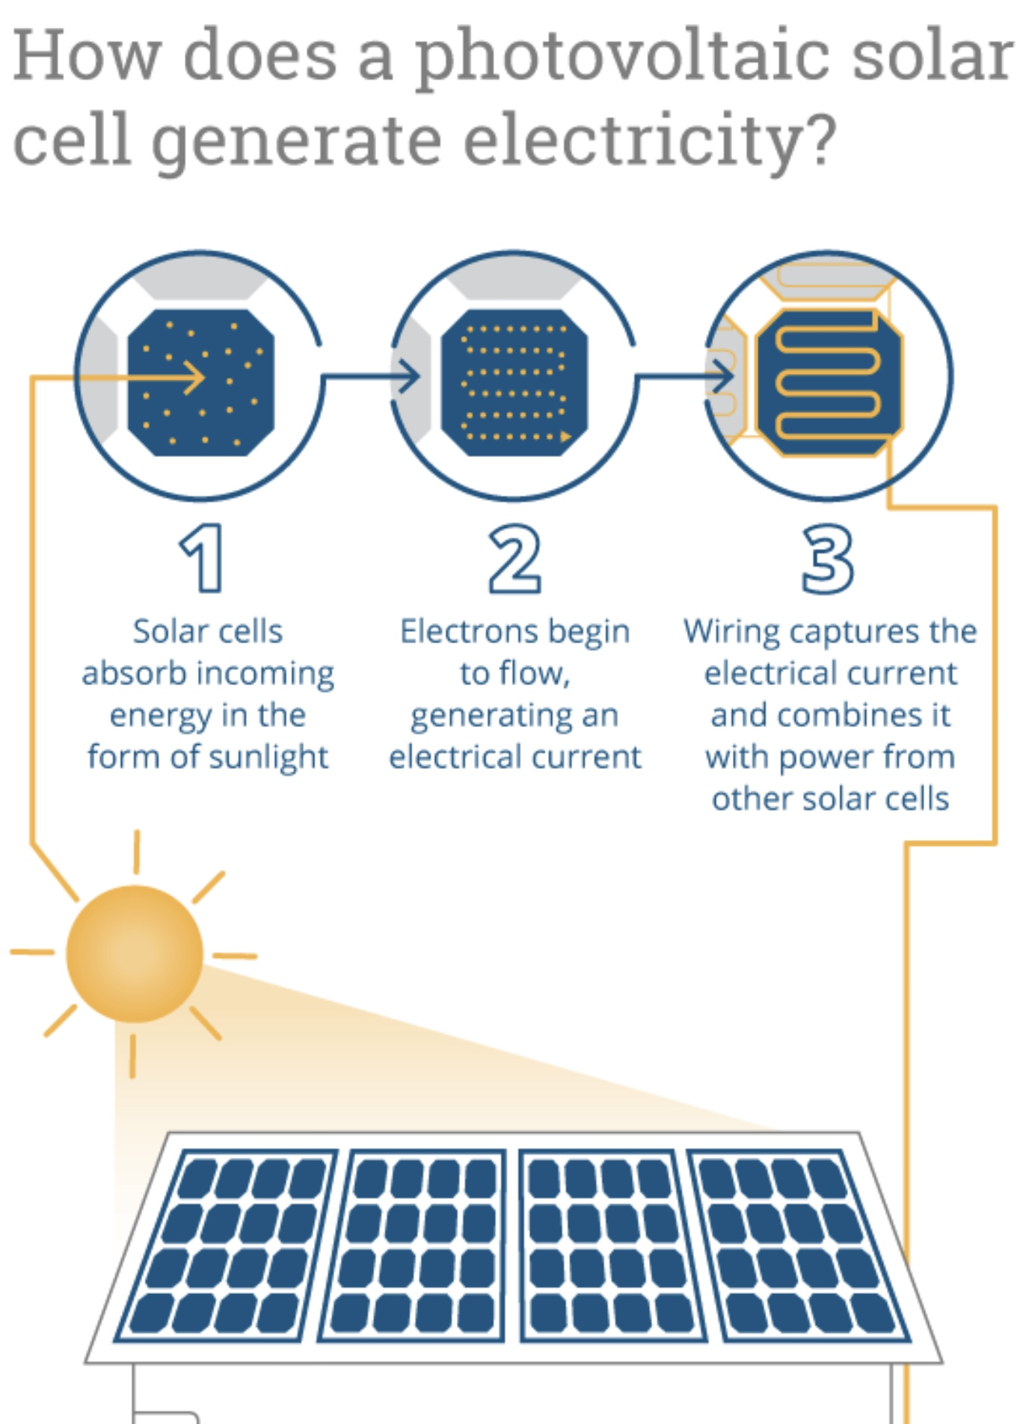
How solar panels work:
When sun’s rays interact with the silicon, electrons move, creating electricity
Each panel has lots of smaller cells wired together
When electrons flow through cells, wiring captures that electricity
Again, converting energy from one form to another

Slide 8
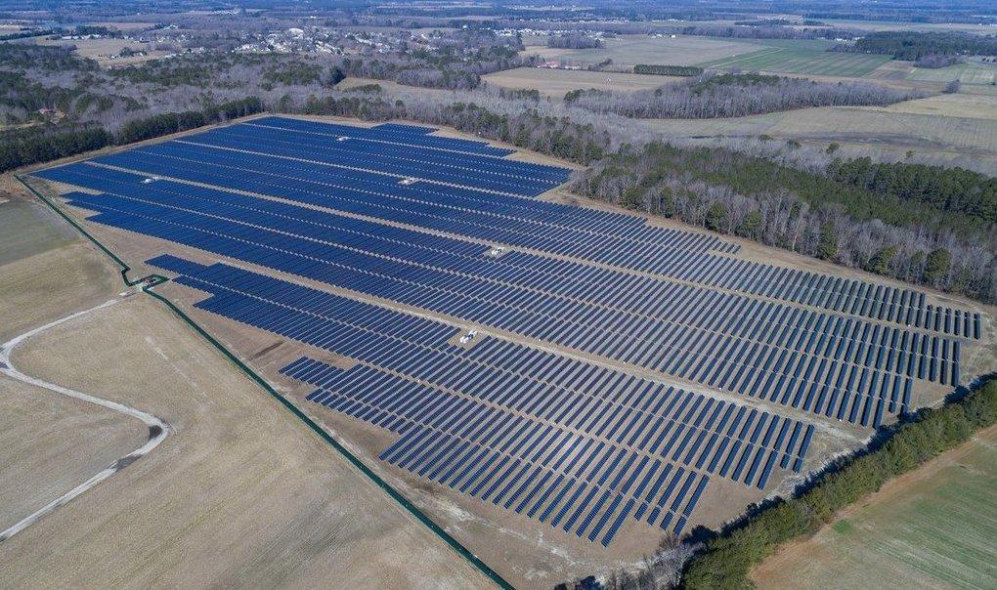

Slide 9
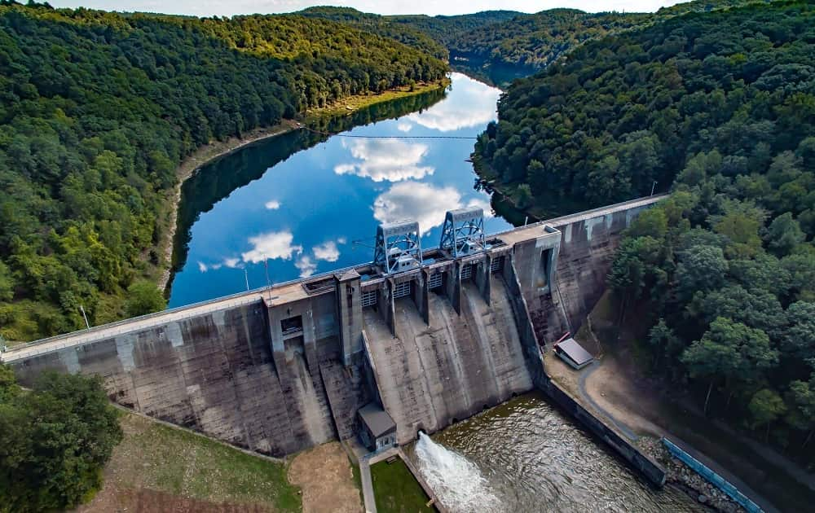
Water for energy production

Slide 10
- water has potential energy initially
- then transferred to kinetic energy
- water flows down through trench and is forced to push a turbine
- turbine generates electricity
- water stores energy very well
- much cheaper to store in water than batteries
Hydroelectric

Slide 11
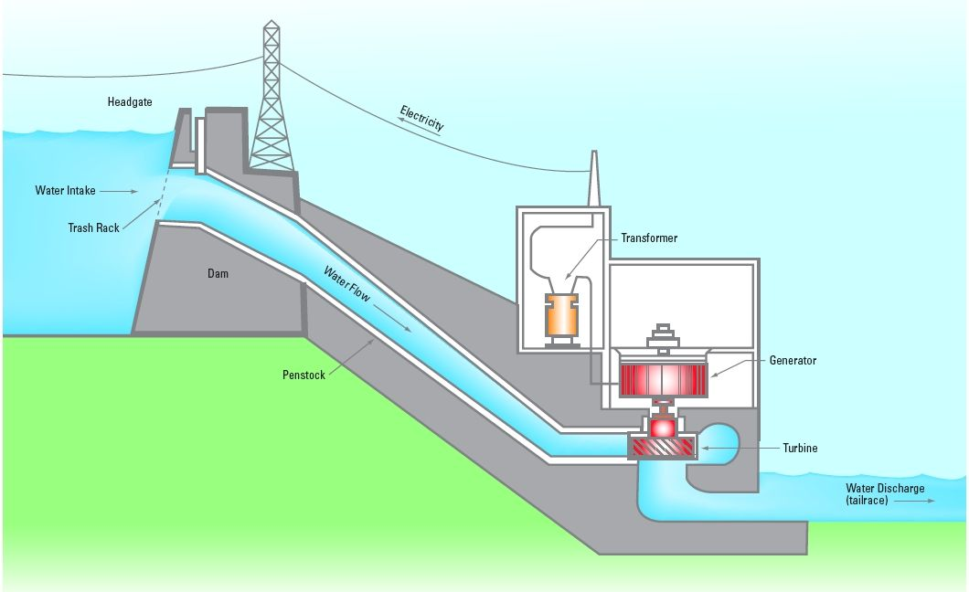

Slide 12
Water stores energy too!
- pump water to top of reservoir
- let it run down again

Slide 13
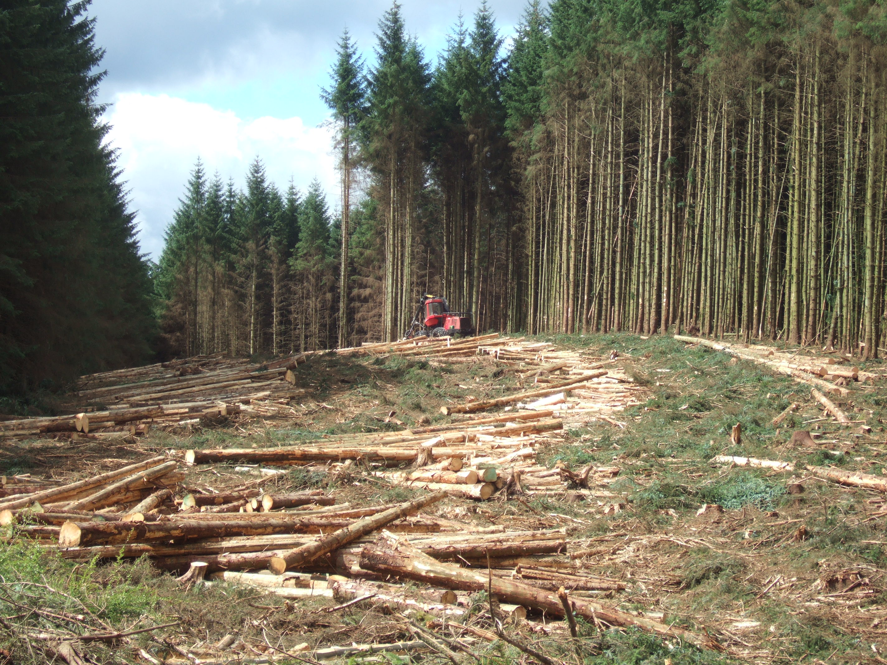
Trees/Biofuels

Slide 14
- This is considered a renewable resource because we have the ability to replenish the supply of trees
- Particulate Matter (~5-10 Microns; bad)
- There are much better forms of NRG production today, so burning trees for energy production is rare (developing countries)
Trees/Biofuel —> Renewable?

Slide 15
Non-renewables

Slide 16
- supply is fixed
- takes millions of years to be created
Reasons for non-renewable

Slide 17
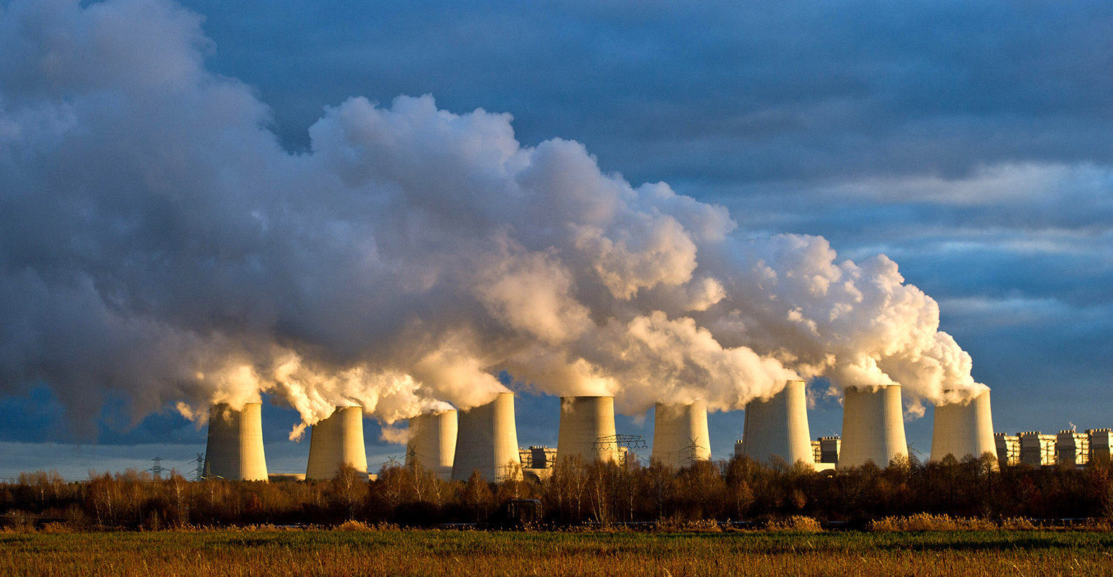
Coal

Slide 18
- Fixed supply of coal
- Takes millions of years to make
- causes Acid rain / immense pollution
- originally used as alternative to burning forests
Coal

Slide 19
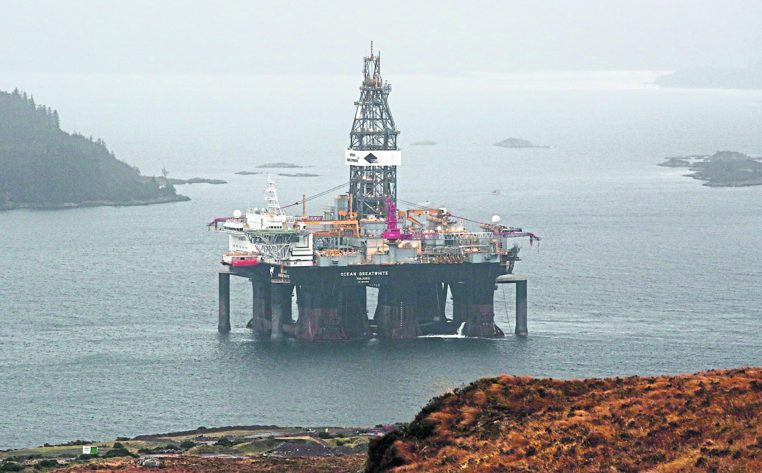
Oil

Slide 20
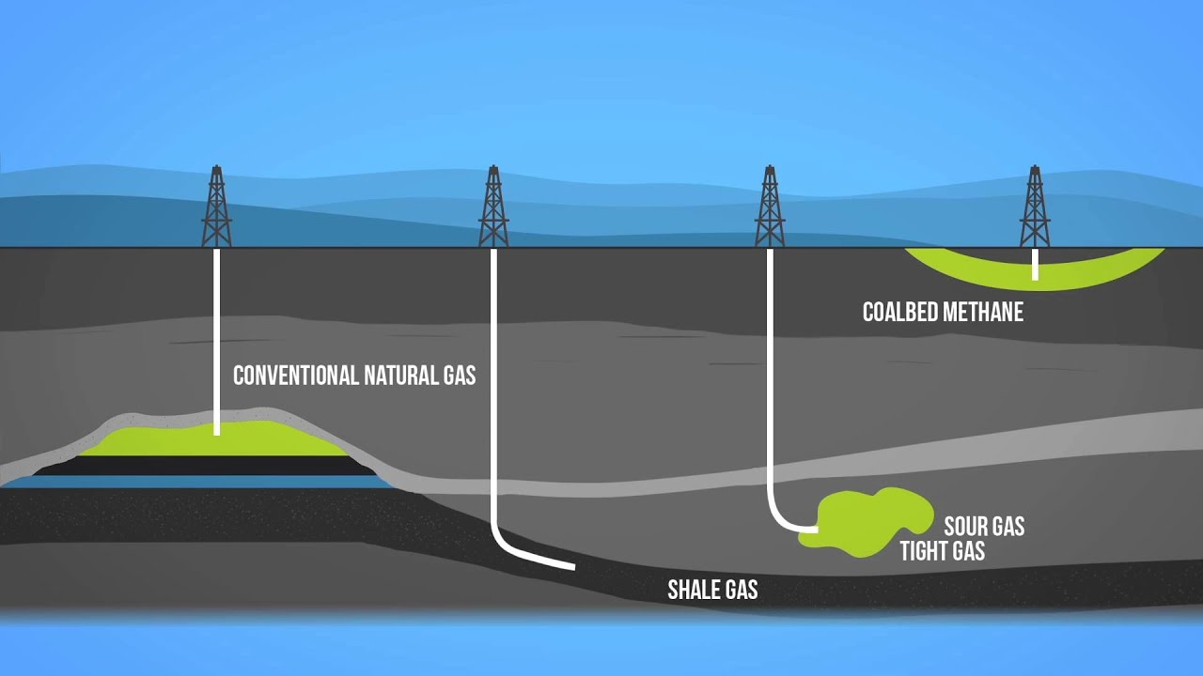
Natural gas

